Slide 1

Presented by :
K. Aasritha Sai Lakshmi — 2520090006
Komali Varnika — 2520090010
Divya Sree — 2520090031
Job Portal with Resume Parsing and Matching
Course: Database Systems Engineering and Distributed Backend Development
Course Code: 25CS1302E
Team No: 12
REVIEW 1

Slide 2

ABSTRACT
  Recruitment can be time-consuming because recruiters have to manually check many resumes.
  The project Job Portal with Resume Parsing & Matching makes the recruitment process faster and easier.Candidates can upload their resumes, and the system automatically extracts skills, education, andexperience.The system compares the candidate's skills with the job requirements.It provides matching score to help recruiters find suitable candidates.
  PostgreSQL/MySQL stores job and candidate information.
  MongoDB stores activity and log information.
  A Vector Database helps in finding candidates with similar skills.
  Overall, the project provides a faster, smarter, and more efficient way to find suitable candidates.

Slide 3

Problem Statement
  Recruiters have to manually screen a large number of resumes.
  Resume screening takes a lot of time and effort.
  Finding the right candidate for a specific job can be difficult.
  Manual matching may not accurately identify candidates whose skills fit the job requirements.
  Managing the complete hiring process can become difficult when the number of applications increases.

Slide 4
Proposed Solution
  Candidate uploads resume
  Resume parsing extracts text & data
  Skills and qualifications identified using NLP
  Job requirements compared with candidate profile
  Matching score generated for suitability
  Recruiter shortlists candidates based on score

Slide 5
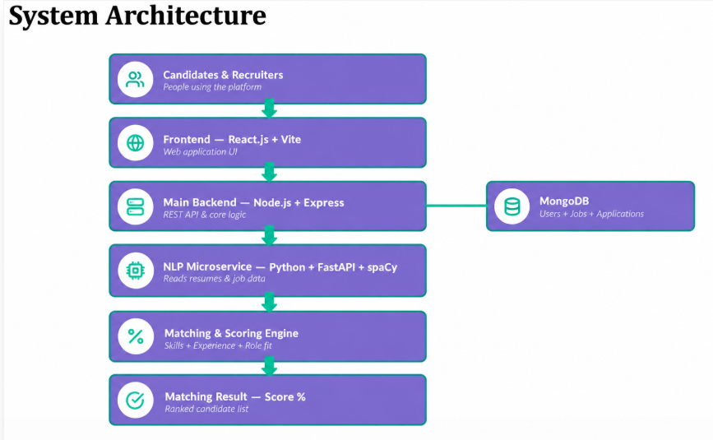

Slide 6
Thank You

